Slide 1
WIKIPEDIA as ontology
Categorize documents using wikipedia articles titles
Federico Testa Edoardo Puglisi

Slide 2
What we want to do?
Categorize a document using Wikipedia as a free and up-to-date ontology.
Reference paper: Peter Schonhofen «Identifying document topics using Wikipedia category network»

Slide 3
PROBLEMS?
BEFORE: Ontologies are small and specific
SOLVED using Wikipedia
NOW: Wikipedia is too large and not rigorous in structure
SOLVED using articles titles only

Slide 4
Related works
The main difference with other similar papers is the exclusive use of articles titles (instead of whole articles text) to prioritize speed
Improvements using links and category hierarchy
Using Hyperlink Texts to Improve Quality of Identifying Document Topics Based on Wikipedia (Dat T. Huynh, Tru H. Cao, Phuong H.T. Pham, Toan N. Hoang)
Wikipedia as an Ontology for Describing Documents (Zareen Saba Syed, Tim Finin and Anupam Joshi)

Slide 5
Related works
The main difference with other similar papers is the exclusive use of articles titles (instead of whole articles text) to prioritize speed
Possible alternative use-case
Discovering missing links in Wikipedia (Sisay Fissaha Adafre, Maarten de Rijke)

Slide 6

datasets
DBPedia
Article titles → categories (30.000.000 entries)
Article redirections → Article titles (15.000.000 entries)
Test Set
X random documents from Wikipedia scraped online

Slide 7



Workflow
Preparing corpus
Notes:
1: Reduce corpus to articles and redirections
2: Perform stop word removal and stemming on article titles,
unite article titles if necessary
3: Remove categories corresponding to Wikipedia administration
and maintenance
4: Remove categories containing less than 5 or more than
5000 documents
5: Merge stub categories with regular ones

Slide 8




Workflow
Preparing corpus
Notes:
1: Reduce corpus to articles and redirections
2: Perform stop word removal and stemming on article titles,
unite article titles if necessary
3: Remove categories corresponding to Wikipedia administration
and maintenance
4: Remove categories containing less than 5 or more than
5000 documents
5: Merge stub categories with regular ones

Slide 9





Workflow
Identifying document topics
Removing stopwords and stemming document
Assigning score to every stem
Collecting titles supported by document words
Assigning score to every title found
Assigning score to every article
Making list of categories of found articles and giving them a score
Improvement
Select best K categories
Word w supports title t if:
w occurs in t
At most 1 of the other title words is not in the doc

Slide 10
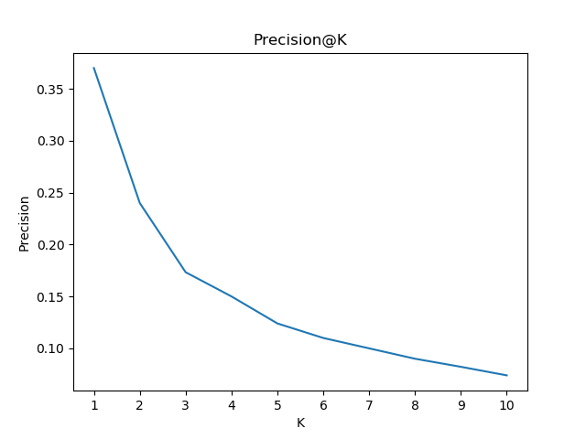
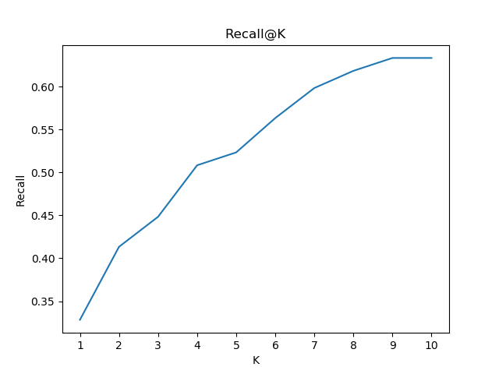
OUR results
precision and recall @K averaged on 100 test documents set

Slide 11
Conclusion
New approach to categorize documents with good results using a wide ontology as Wikipedia can be.
Future works
Use hyperlink connecting articles and categories hierarchy for improvements
Use best K category scores as features to represent documents in a vector space model and classify them (SVM, NB, NN)

Slide 12
Thanks for your attention

